Slide 1

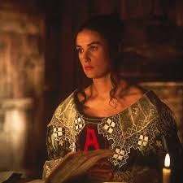
The Scarlet Letter By: Simra Aziz

Slide 2
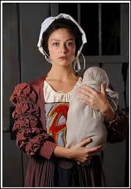
A – Adultery Connection: Hester’s crime of adultery is the reason she wears the scarlet “A.” Importance: It sets the entire conflict in motion and symbolizes sin, shame, and societal judgment.
A

Slide 3
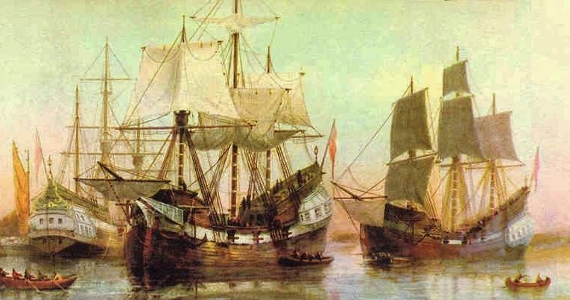
B – Boston Connection: The Puritan settlement where the story unfolds. Importance: The rigid, religious community highlights the clash between individuality and conformity.
B

Slide 4
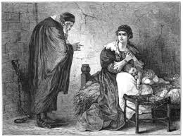
C – Chillingworth Connection: Hester’s estranged husband who seeks revenge on Dimmesdale. Importance: He embodies vengeance and moral corruption, showing how obsession destroys humanity.
C

Slide 5
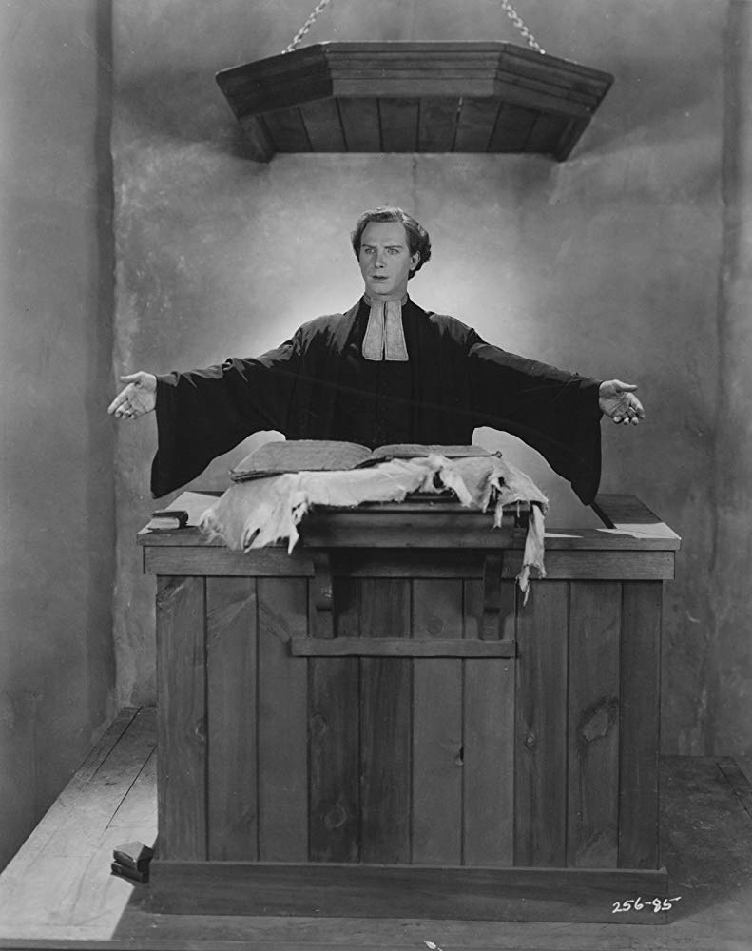
D – Dimmesdale Connection: The minister who secretly shares Hester’s sin. Importance: His hidden guilt explores hypocrisy, inner torment, and the destructive power of secrecy.
D

Slide 6
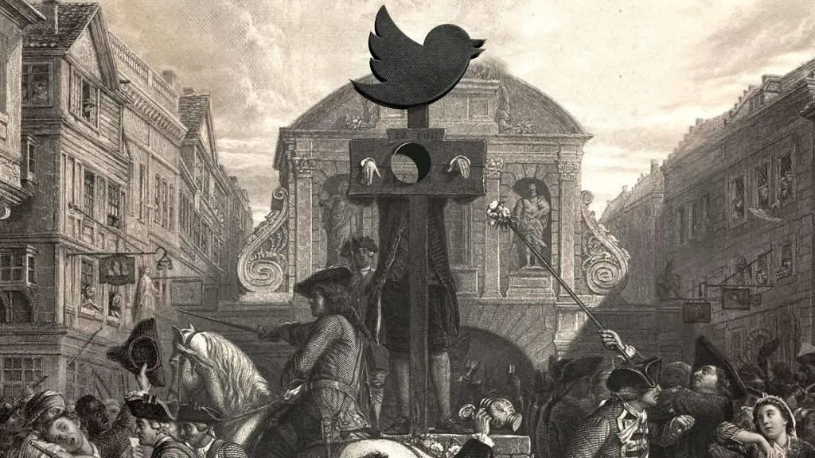
E – Exile Connection: Hester is socially exiled despite remaining in Boston. Importance: Demonstrates how shame isolates individuals but also fosters resilience and independence.
E

Slide 7
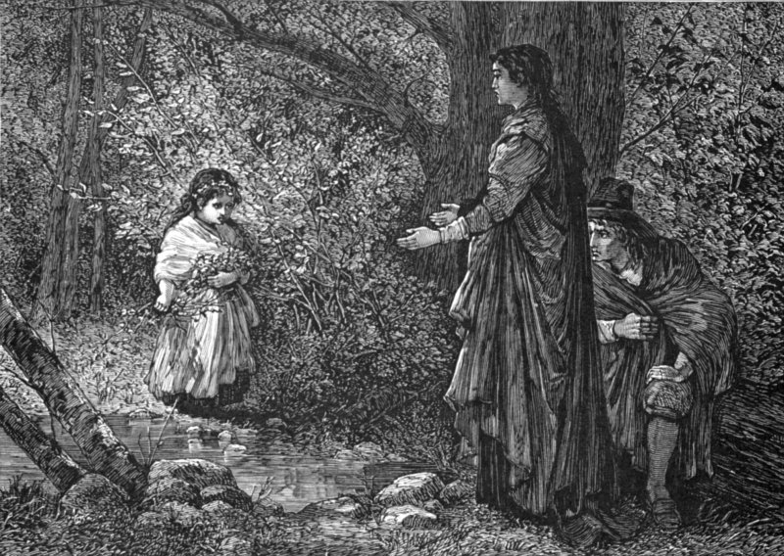
F – Forest Connection: A place of freedom where Hester and Dimmesdale meet. Importance: Symbolizes nature, truth, and escape from societal constraints.
F

Slide 8
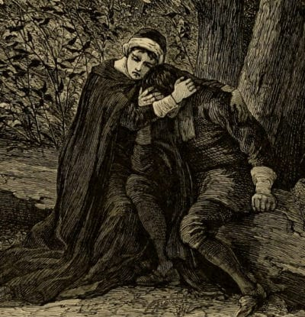
G – Guilt Connection: Dimmesdale’s hidden guilt consumes him physically and spiritually. Importance: Shows how internalized shame can be more destructive than public punishment.
G

Slide 9
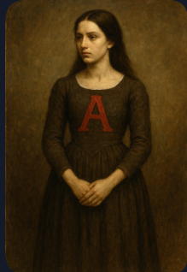
H – Hester Prynne Connection: The protagonist who bears the scarlet letter. Importance: She represents strength, dignity, and the possibility of redemption.
H

Slide 10
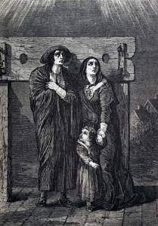
I – Identity Connection: Hester redefines the meaning of the “A” through her charity and strength. Importance: Explores how identity can be reshaped despite societal labels.
I

Slide 11
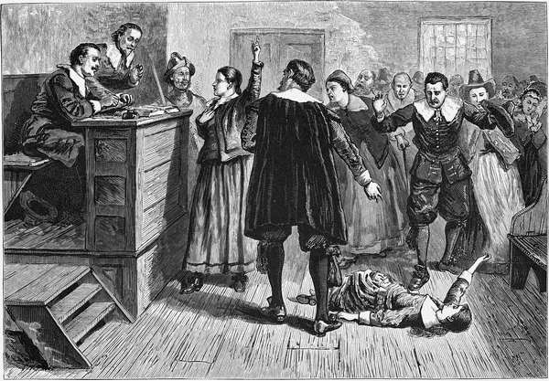
J – Judgment Connection: The Puritan community harshly judges Hester. Importance: Highlights the dangers of moral absolutism and collective condemnation.
J

Slide 12
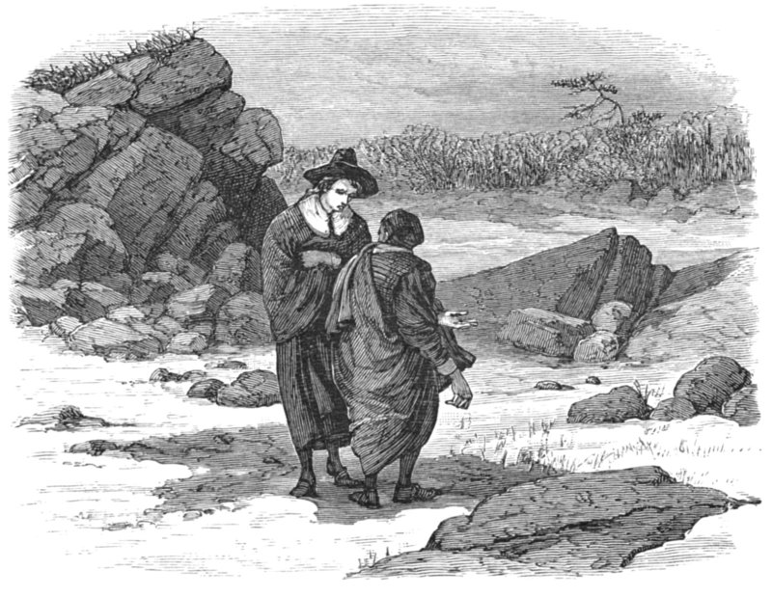
K – Kindness Connection: Hester shows kindness through her charitable acts. Importance: Her compassion transforms the meaning of the scarlet letter from shame to respect.
K

Slide 13
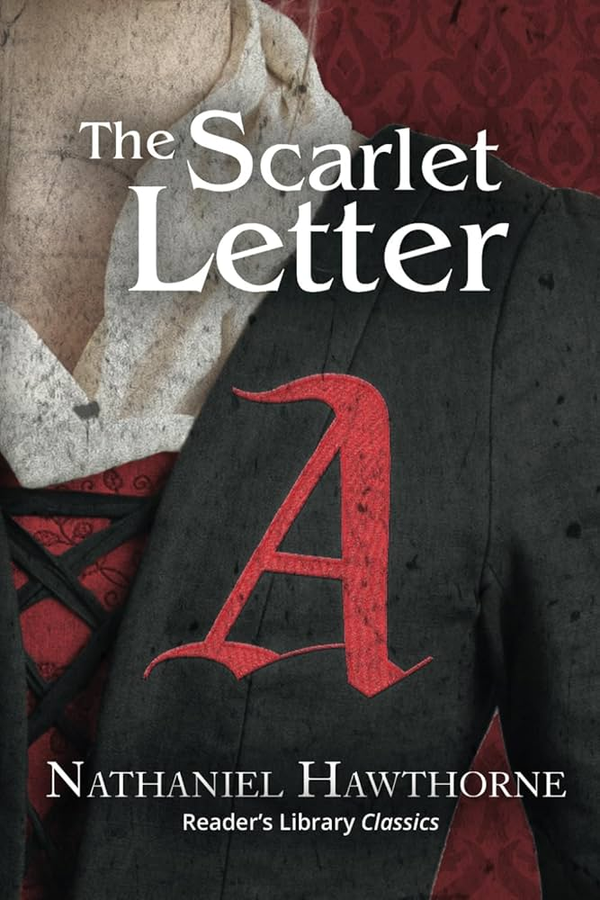
L – Letter “A” Connection: The central symbol of the novel. Importance: Its meaning evolves from “Adultery” to “Able,” showing the fluidity of symbols.
L

Slide 14
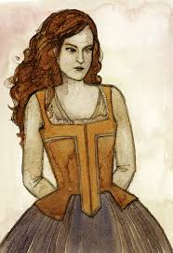
M – Mistress Hibbins Connection: A woman accused of witchcraft who tempts Hester. Importance: Represents the dark, supernatural fears of Puritan society.
M

Slide 15
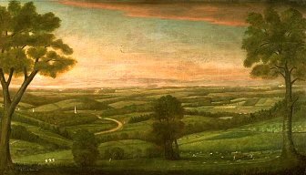
N – Nature Connection: The forest and Pearl’s wildness contrast with rigid Puritan order. Importance: Suggests truth, freedom, and authenticity outside societal rules.
N

Slide 16
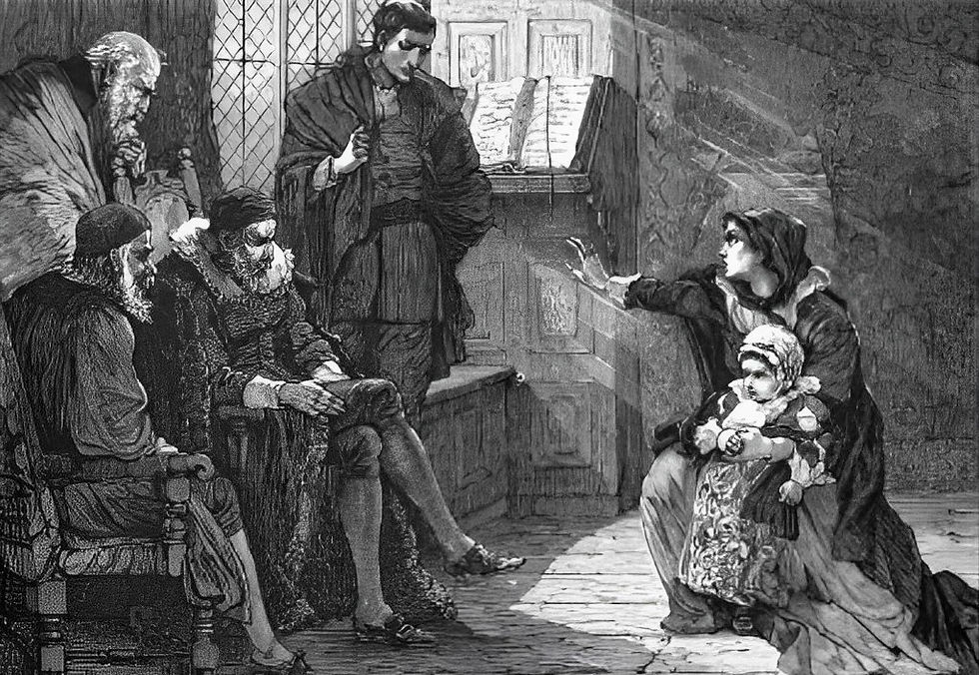
O – Ostracism Connection: Hester is shunned by society. Importance: Demonstrates how communities enforce conformity through exclusion.
O

Slide 17
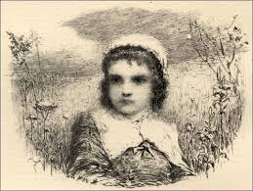
P – Pearl Connection: Hester’s daughter, born of sin but full of vitality. Importance: Symbolizes both punishment and hope, embodying truth and natural innocence.
P

Slide 18
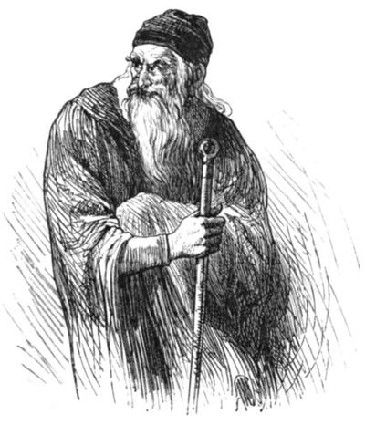
Q – Quest Connection: Dimmesdale’s quest for redemption and Hester’s quest for dignity. Importance: Shows the human struggle for meaning and forgiveness.
Q

Slide 19
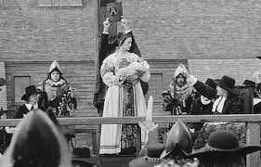
R – Redemption Connection: Hester earns respect through her strength and service. Importance: Suggests that even those condemned can achieve grace and transformation.
R

Slide 20
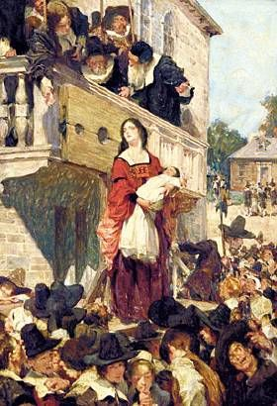
S – Scaffold Connection: The site of Hester’s public shaming and Dimmesdale’s confession. Importance: Symbolizes exposure, truth, and the stages of guilt and redemption.
S

Slide 21
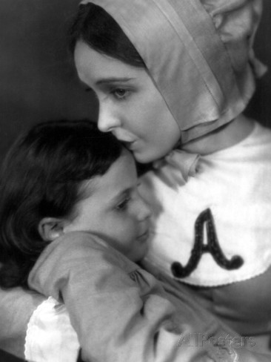
T – Truth Connection: Pearl constantly demands honesty from her parents. Importance: Truth is necessary for healing and freedom, contrasting with secrecy and hypocrisy.
T

Slide 22
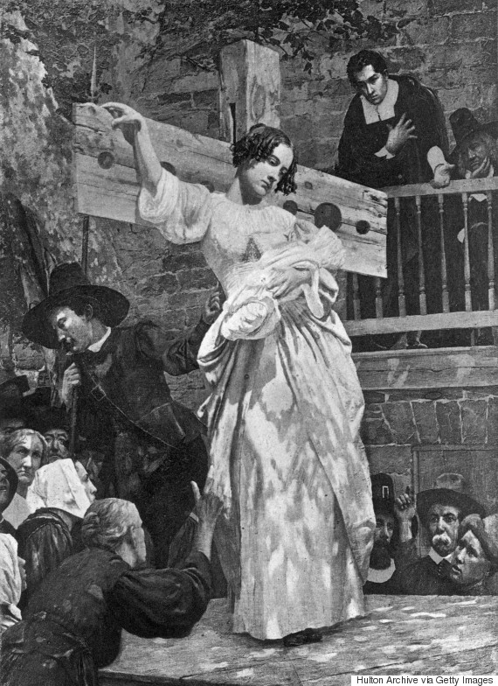
U – Unforgiving Society Connection: The Puritans refuse to forgive Hester. Importance: Critiques rigid moral codes and lack of compassion.
U

Slide 23
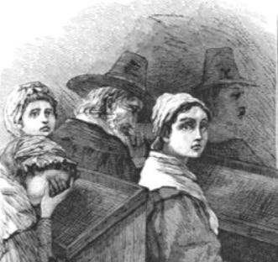
V – Vengeance Connection: Chillingworth’s obsession with punishing Dimmesdale. Importance: Shows how revenge corrupts and consumes the soul.
V

Slide 24
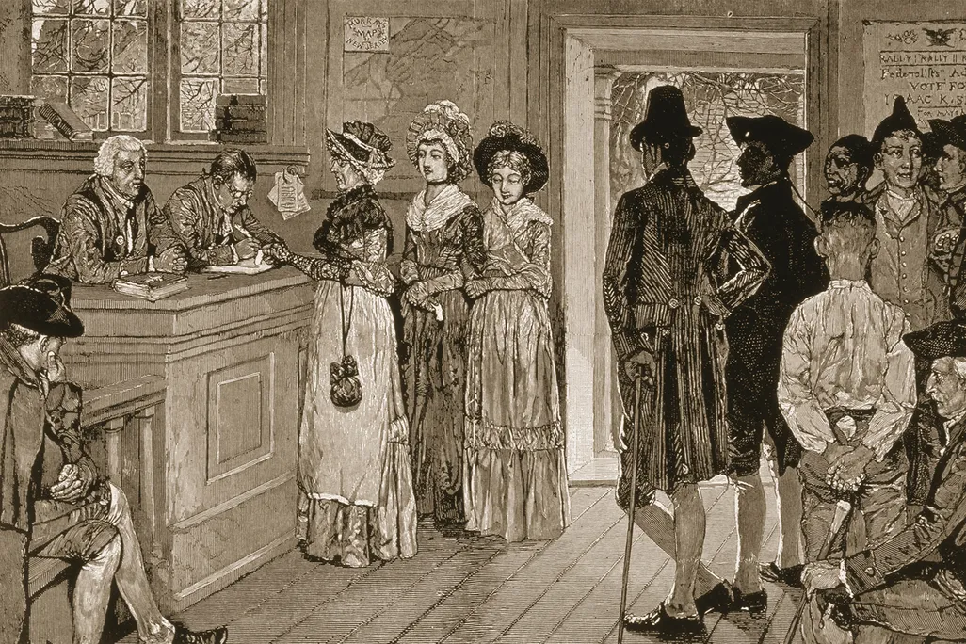
W – Women Connection: Hester challenges gender roles by living independently. Importance: Explores women’s strength and resilience in a patriarchal society.
W

Slide 25
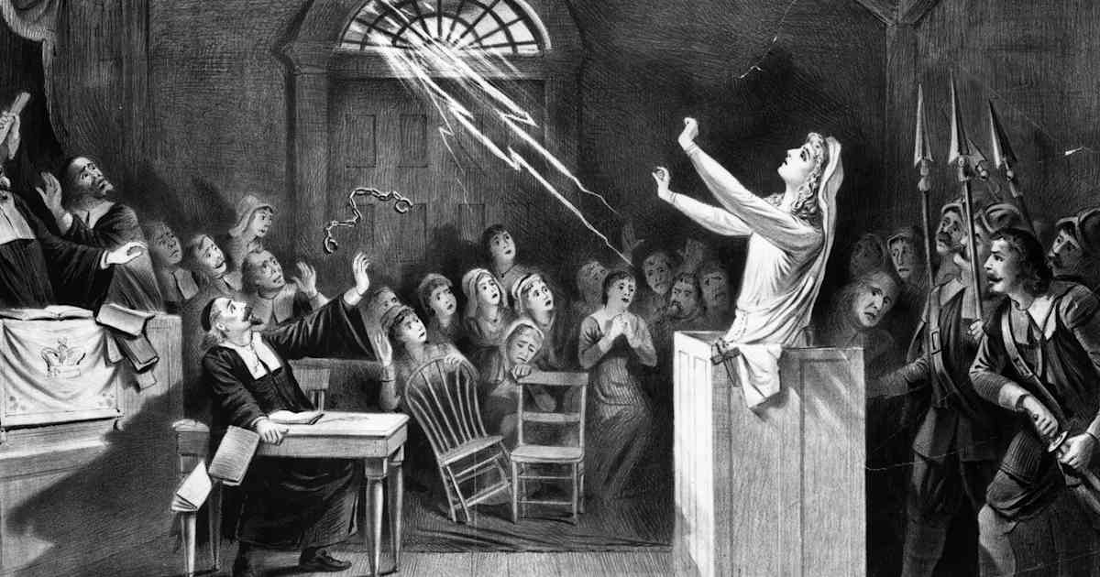
X – Xenophobia Connection: The Puritans fear outsiders and difference. Importance: Reflects the dangers of intolerance and rigid conformity.
X

Slide 26
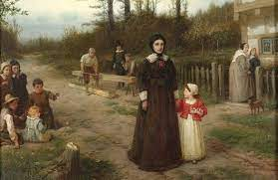
Y – Youth Connection: Pearl’s youth contrasts with the heavy guilt of adults. Importance: Suggests innocence, possibility, and the future beyond sin.
Y

Slide 27
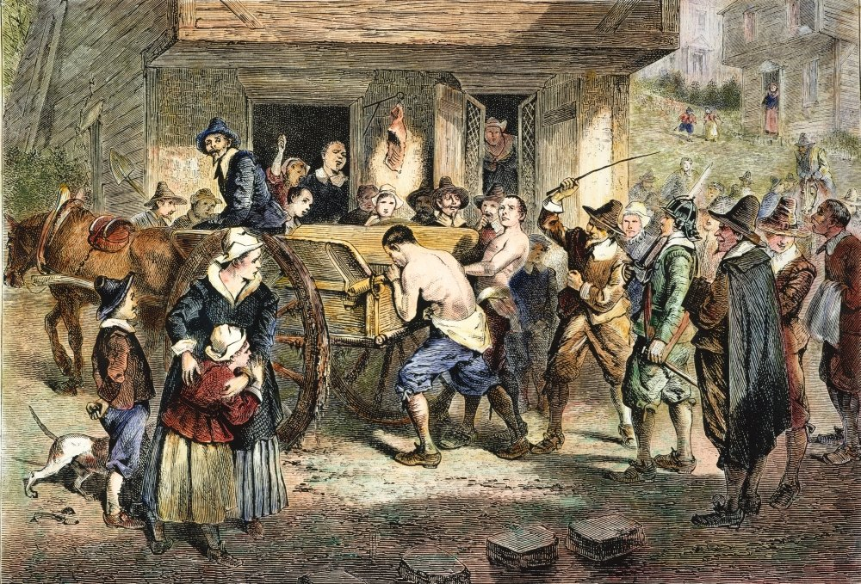
Z – Zealotry Connection: The Puritans’ religious zealotry drives their harsh punishments. Importance: Critiques fanaticism and the dangers of blind faith.
Z

